Slide 1
Star and snowflake schema
Presented by:
Shehryar Khan

Slide 2
What is Data warehouse schema?
Schema is a logical description of the entire database.
It includes the name and description of records of all record types.

Slide 3
Types of Data Warehouse Schema
Star Schema
Snowflake Schema
Galaxy Schema

Slide 4
Star Schema
In a star schema , there is one fact table in the middle and a number of associated dimension tables. This structure resembles a star and hence it is known as a star schema.
Each dimension in a star schema is represented with only one-dimension table.
This dimension table contains the set of attributes.
The following diagram shows the sales data of a company with respect to the four dimensions, namely time, item, branch, and location.

Slide 5
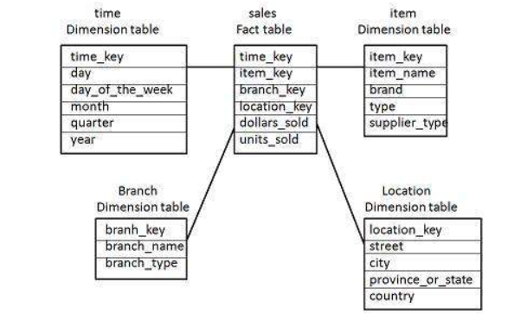
Star Schema diagram
https://www.tutorialspoint.com/dwh/dwh_schemas.htm

Slide 6
Star Schema (continued)
There is a fact table at the center. It contains the keys to each of four dimensions.
The fact table also contains the attributes, namely dollars sold and units sold.
Highly data redundancy.

Slide 7
Snowflake Schema
Snowflake schema acts like an extended version of a star schema.
There are additional dimensions added to Star schema. This schema is known as snowflake due to its structure.
Some dimension tables in the Snowflake schema are normalized.
The normalization splits up the data into additional tables.

Slide 8
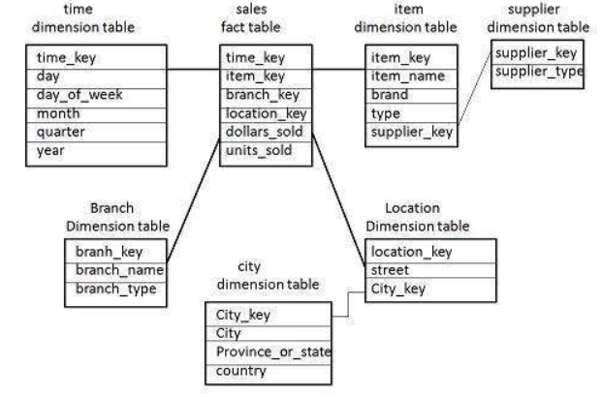
Snowflake schema diagram
https://www.tutorialspoint.com/dwh/dwh_schemas.htm

Slide 9
Snowflake schema (continued)
The dimensions table in a snowflake schema are normalized. For example, the item dimension table is normalized and split into two dimension tables, namely item and supplier table.
Due to normalization in the Snowflake schema, the redundancy is reduced and therefore, it becomes easy to maintain and the save storage space.

Slide 10
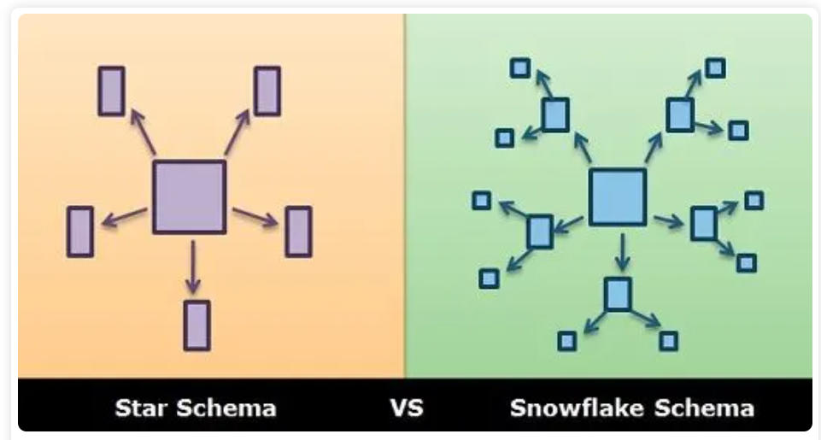
Comparing Star and Snowflake Schema
https://techdifferences.com/difference-between-star-and-snowflake-schema.html

Slide 11
Comparison table
BASIS FOR COMPARISON | STAR SCHEMA | SNOWFLAKE SCHEMA
Structure of schema | Contains fact and dimension tables. | Contains sub-dimension tables including fact and dimension tables.
Use of normalization | Doesn't use normalization. | Uses normalization and denormalization.
Ease of use | Simple to understand and easily designed. | Hard to understand and design.
Query complexity | Low | High
Foreign key join used | Fewer | Large in number
Space usage | More | Less
Time consumed in query execution | Less | More comparatively due to excessive use of join.

Slide 12
conclusion
Star and Snowflake schema is used for designing the data warehouse. Both have certain merits and demerits where snowflake schema is easy to maintain, lessen the redundancy hence consumes less space but complex to design. Whereas star schema is simple to understand and design, uses less number of joins and simple queries but have some issues such as data redundancy and integrity.
However, use of snowflake schema minimizes redundancy, but it is not popular as star schema which is used most of the time in the design of data warehouse.

Slide 13
Thank you

